Slide 1
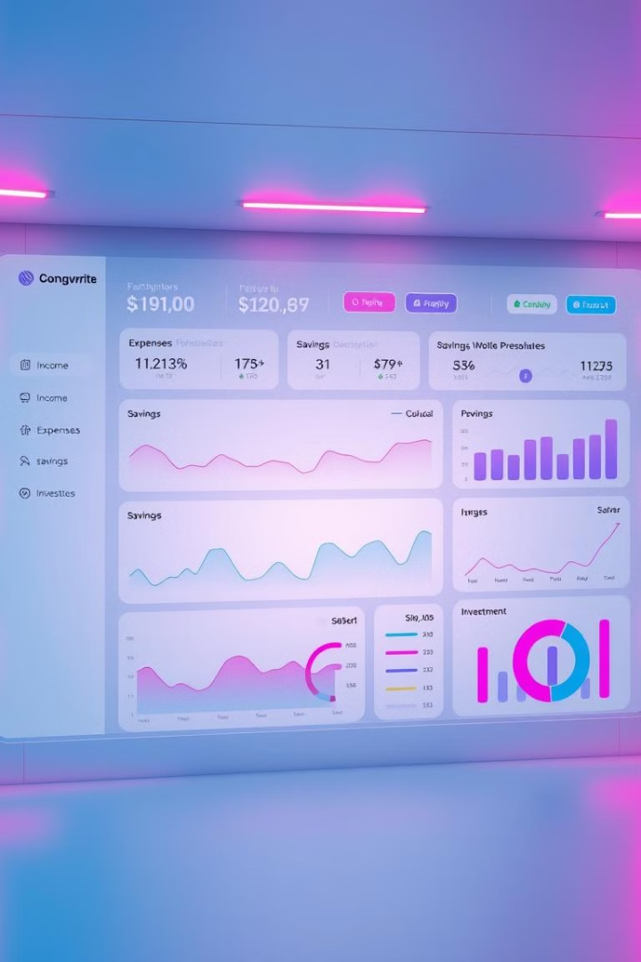

Personal Finance Dashboard
Welcome! Today, we will be presenting our personal finance dashboard project, designed to empower users with a comprehensive overview of their financial health.
by Mohammed Sufiyan Ahmed

Slide 2

Problem Statement
1
Lack of Visibility
2
Time-Consuming
Many individuals struggle to track their finances effectively. They lack a centralized platform to monitor income, expenses, and savings.
Manually managing personal finances can be time-consuming and prone to errors.
3
Limited Insights
Without a clear picture of spending patterns, individuals miss opportunities to optimize their finances.

Slide 3

Approach/Methodology and Tech Stack
1
Data Collection
We use APIs to connect to various financial institutions and automatically gather transaction data.
2
Data Processing
We employ a combination of Python and SQL for data cleaning, transformation, and analysis.
3
Dashboard Development
We leverage a JavaScript framework (React) for interactive and responsive user interfaces.
4
Visualization
Charts and graphs are generated using a charting library, such as Chart.js, for intuitive data representation.

Slide 4
Uniqueness and Future Scope
Uniqueness
Future Scope
User-friendly interface
Integration with investment platforms
Personalized financial insights
Advanced forecasting and goal setting
AI-powered budgeting assistance
Gamification and financial education

Slide 5
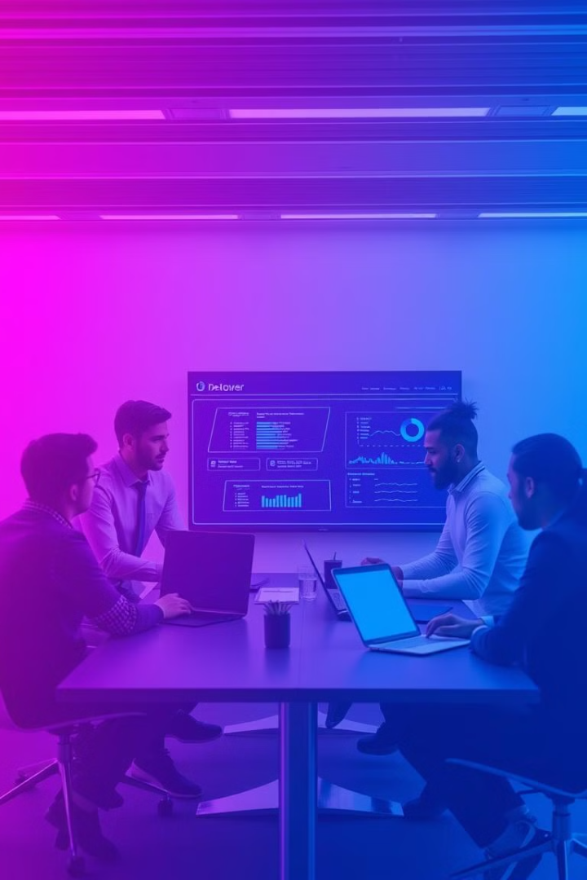
Challenges
Data Security
Ensuring the secure handling of sensitive financial information.
Data Integration
Connecting to multiple financial institutions and standardizing data formats.
Performance Optimization
Maintaining fast loading times and responsiveness, even with large datasets.

Slide 6
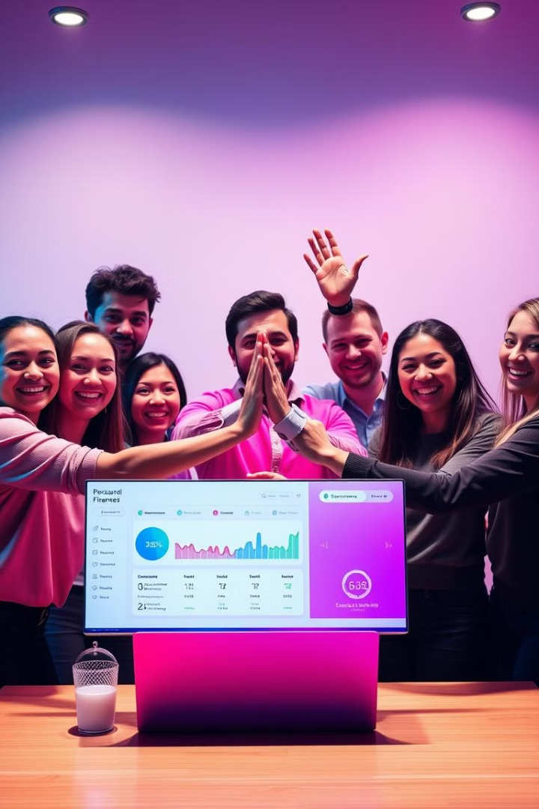
Conclusion and Thank You
Our personal finance dashboard empowers users to take control of their finances. We envision a future where this tool helps individuals make informed financial decisions and achieve their goals.
Thank you for your time and consideration.

